Slide 1


PROGESS LOG
Edited by
Loek Ehren
Mike Schatorjé
Simone Francesconi
Herm Lecluse
Rick van Osch

Slide 2
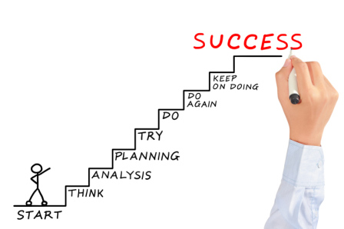
The project 1/3
Quick Goals:
Make the city’s underground garbage containers “digital”
Optimize the Waste Collection System
New Garbage collection system processes
New web application

Slide 3

In brief, how to do it?

Slide 4
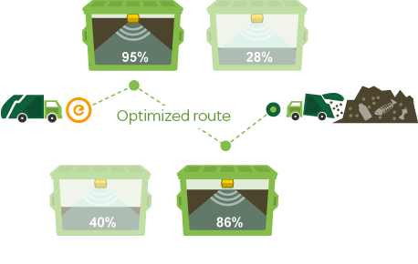
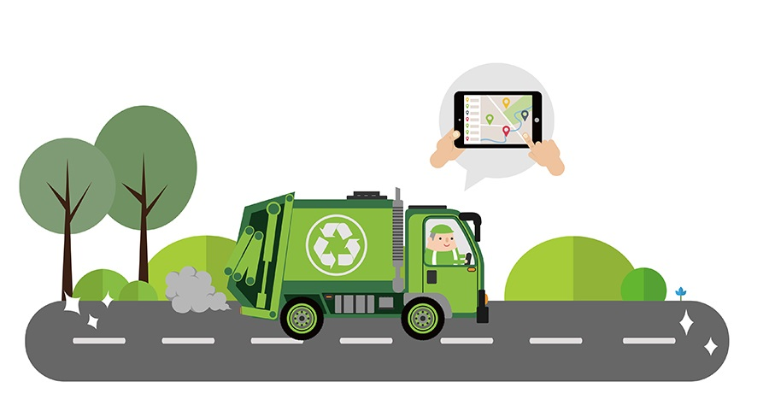
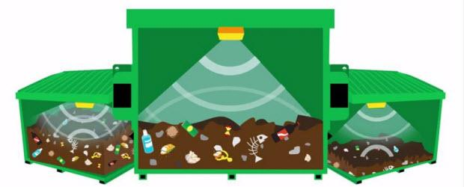
The project 2/3
New processes for a new system
Through sensors, understand the fill level of the containers
Through Google tools, optimize the vehicle route

Slide 5
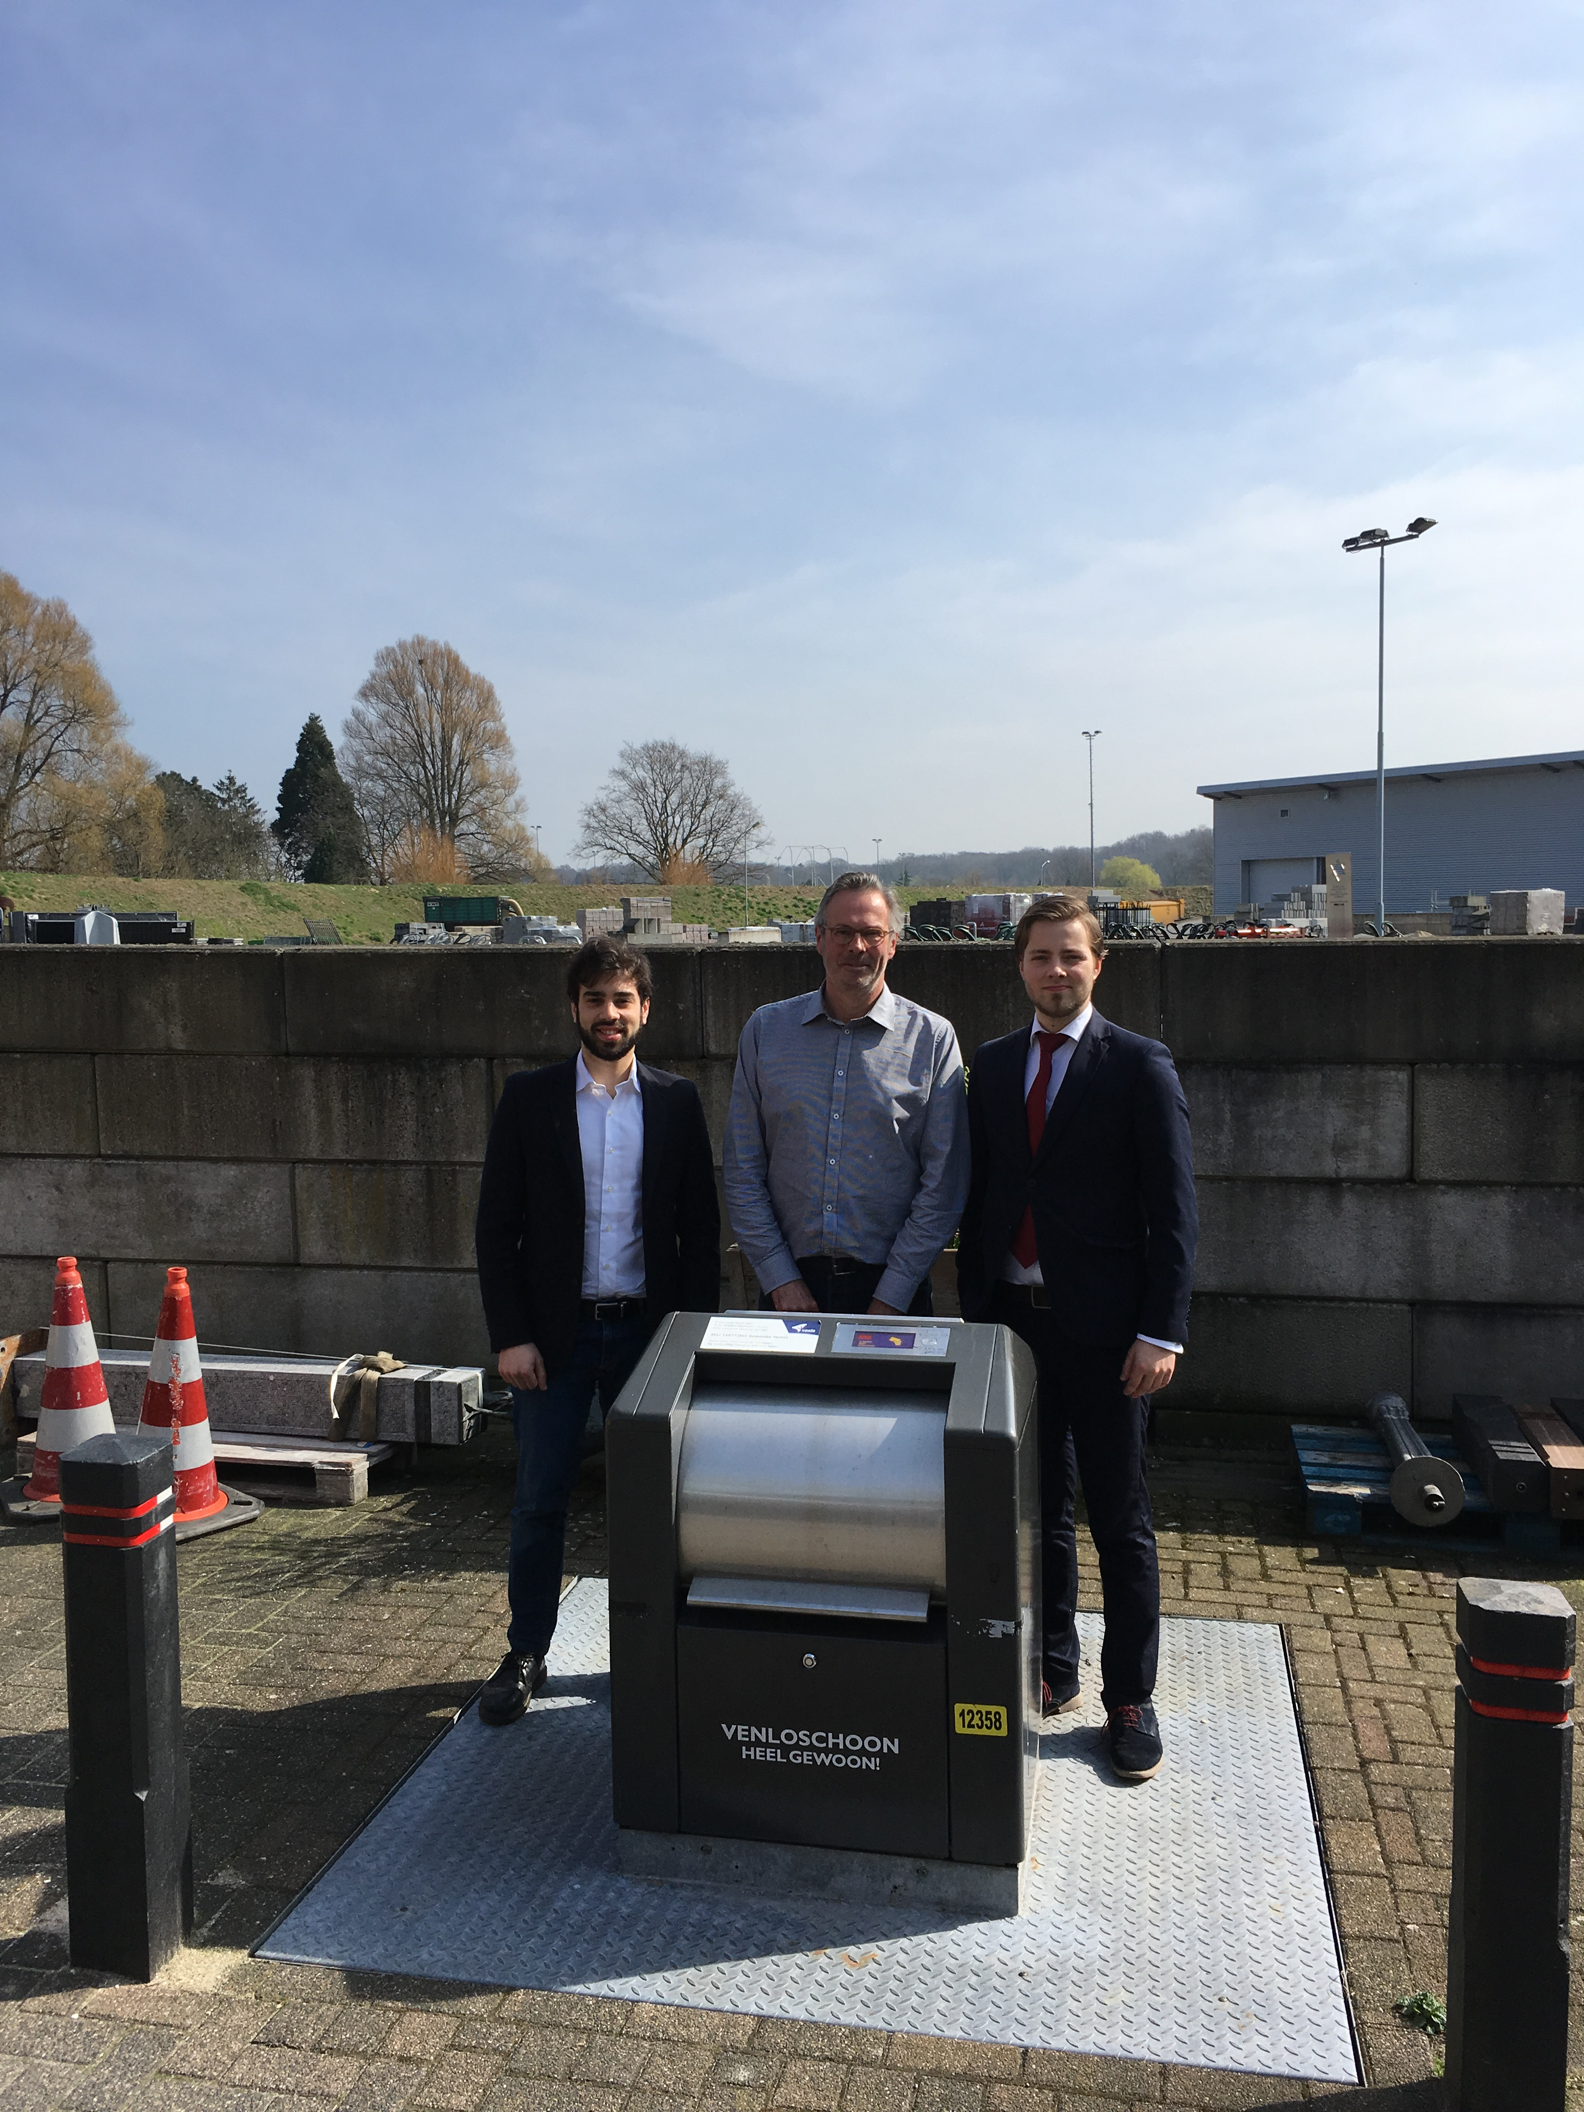
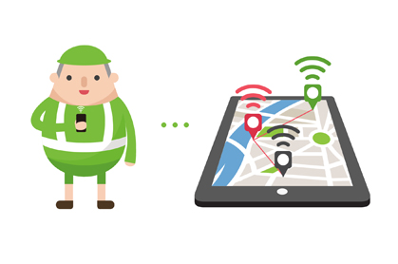
The project 3/3
Through interviews, get the processes data we need from the stakeholders
Through surveys and online research, build a customized web applications for citiziens

Slide 6
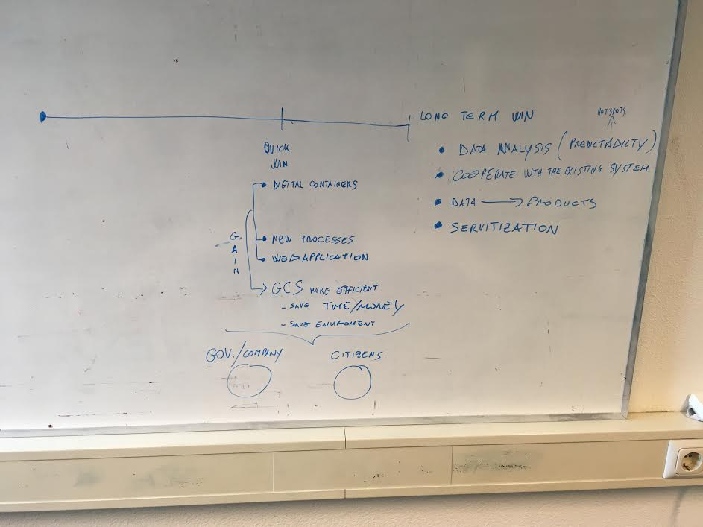
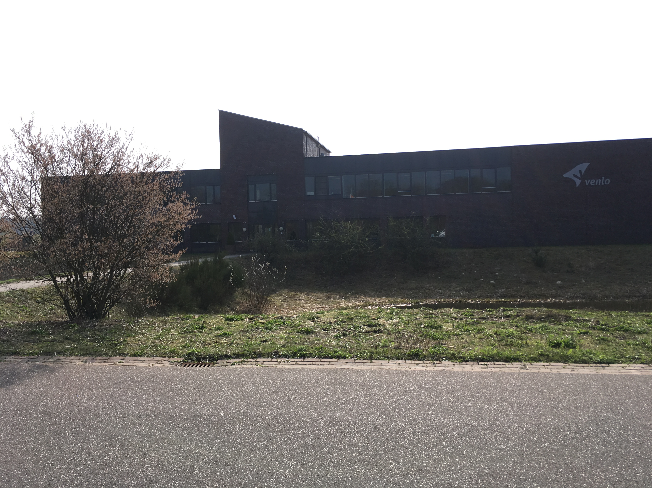
The project: phases
Research
>Brainstorming / whiteboard
>Interview, Gathering data
Design
Development

Slide 7

What did we want to achieve?
To finish test application
Get the equipment we ordered
Set up the “Raspberry pi”
Prepare the test plan
Updating the interview and perform the interview itself

Slide 8
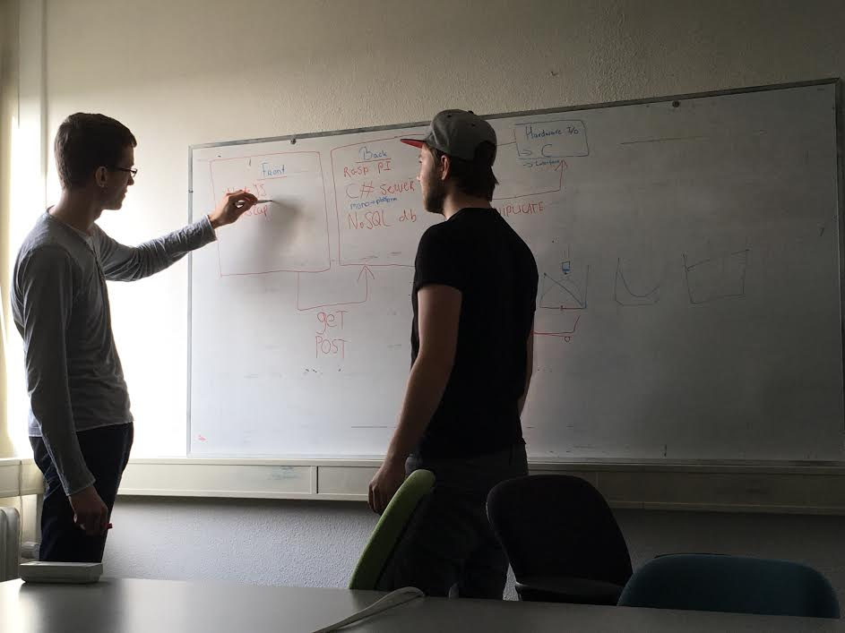
How did we do it?
Brainstorming / whiteboard
Continuing in development
Ask the teacher for the equipment order
Using a template
Visit the public environment department
Divided test application in 3 parts:
Frontend
Backend
Hardware I/O

Slide 9

What were the results?
The equipment has not been delivered yet (Friday afternoon)
Test plan almost finished
finished test application with:
>Frontend
>Backend
>Hardware I/O (mocked)
Get part of the information we need, and part of extra information we have not thought about

Slide 10
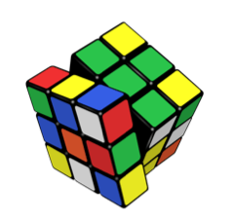
What were the problems?
Equipment didn’t arrive yet
Some problem with the firewall
We didn’t get all the information about the processes
TheThings “Uno” is not deliverable before the end of April

Slide 11

What were the lessons learned?
Civil servants are quite friendly and available to answer most of our questions
Proper project plan is really important
Making a proper risk management is very useful

Slide 12
What do we want to achieve?
Doing proper risk management lists
Process the interview
Final preparation for testing and maybe start
Get the information from the interview

Slide 13

How we are going to do it?
Brainstorming/discussing
Through professor’s slides and online researches
Looking what is still necessary for the testing
Listen to the audio and figure out the information we got from the interview
…

Slide 14
Any Question?
Thanks for your attention!

